Slide 1
Unit 2 Theory of ageing

Slide 2
Con..
Aging can be defined as “a progressive and generalized impairment of function resulting in the loss of adaptive response to stress and increased risk of age related diseases”.
The overall effect of these alterations is an increase in the probability of declining health and dying.
is the accumulation of Irreversible changes in a person over time. Ageing in humans refers to a multidimensional process of physical, psychological, and social changes.
Aging process is progressive, but not all individual necessarily show signs of aging at the chronological age.

Slide 3
Con..
Aging is an inevitable and universally shared experience. It is a normal physiological and developmental process causing a progressive decrease in functional capabilities which begins at conception and ends at death.
Ageing refers to the increasing inability of the body to maintain itself and to perform the functions it once did.
Ageing is a complex process that can be described chronologically, biologically and psychologically.

Slide 4
Categories of aging population
Chronological categories of old age:
Young –Old- (ages 60-75)
Middle- Old- (ages75-85)
Old- Old- (ages 85 and older)

Slide 5

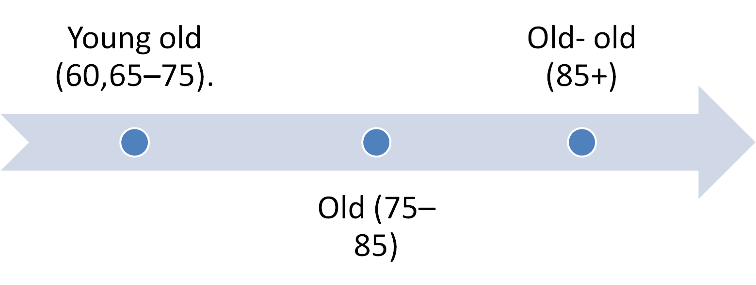
Chronological Classification of Old Age

Slide 6
Con..
Biological age: (age by body function)
It is defined as a description of an individual development based on biomarkers. A biomarker is a recordable molecular or cellular event. Biological marker can be younger or older than chronological age. Ex: puberty, menopause.

Slide 7
Con..
Psychological Age: (age how individuals feels it)
It refers to the behavioral capacity of the person to adapt changing environmental demands and includes capacities of memory, learning, intelligence, skills, feelings and motivation for exercising behavioral control or self regulation.
Social Age:
It results from the person life course and experiences, refers to roles and habits of person with respect to other members of society.

Slide 8
Con..
Functional Age:
It is defined as a combination of chronological, biological, and psychological ages.
Cognitive Age:
It includes the age the person feels and looks to self, plus the fit of behavior and interests to his or her chronological age.
Example: I do most things as if I were --- years old.

Slide 9
Healthy Ageing
WHO defines Healthy Ageing as “the process of developing and maintaining the functional ability that enables well-being in older age.”Functional ability comprises the health-related attributes that enable people ‘to be and to do what they have reason to value.’ It is made up of the intrinsic capacity of the individual, relevant environmental characteristics and the interactions between the individual and these characteristics.
Intrinsic capacity- is the composite of all the physical and mental capacities of an individual
Environment- comprise all the factors in the extrinsic world that form the context of an individual’s life. These include home, communities and the broader society.

Slide 10
Successful Aging
Refers to those who have aged successfully managed to avoid serious, debilitating diseases and disability. Successful ageing is of those senior citizens who;
  Avoid serious, debilitating diseases and disability.
  Engage independently in most normal activities of daily living.
  Maintain cognitive function.
  Are able to cope with physical, social, and emotional changes
  Have sense of control in different aspects of their lives

Slide 11
Theories of aging; Classification
There is no single theory of ageing; different physical and psychosocial theories of aging have been proposed and tested , what specifically causes ageing is unknown.
Following theories are related to ageing:
Biological theory
Psychosocial theory
Environmental theory
Developmental theory

Slide 12
There are more than 300 theories of ageing.

Slide 13
Biological Theories
The theory views ageing as a progressive loss of body function due to deleterious effects over time. Biological ageing is the multifactorial process involving genetics, oxidative stress, diet, environment, decreasing structural function etc.
1. Biologic clock theory-
States that inside each of us is a clock of aging, a genetically determined program dictating the occurrence of aging and dying. The biological clock may be inside the cell nucleus and after a set number of reproductions; the cell is old and dies as the cell has a finite life span.
Notes:
Deleterious:harmful

Slide 14
Con..
Stochastic :ageing occurs randomly
Non stochastic :ageing is pre determined through programmed cell changes.changes through neuro endocrine and immunologic system.

Slide 15
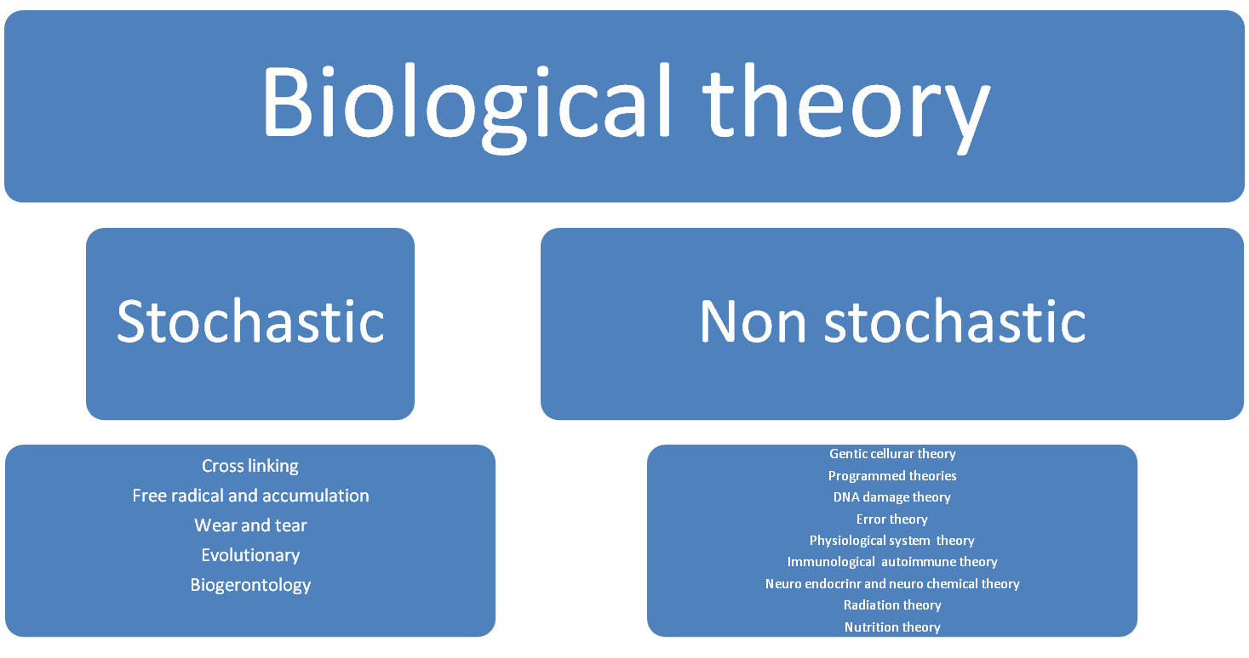

Slide 16
Biological Theory
Stochastic:
Cross linking
Free radical and accumulation
Wear and tear
Evolutionary
Biogerontology
Non stochastic
Gentic cellurar theory
Programmed theories
DNA damage theory
Error theory
Physiological system theory
Immunological autoimmune theory
Neuro endocrinr and neuro chemical theory
Radiation theory
Nutrition theory
Environmental

Slide 17
Cross-Linkage Theory:
The cross-linking theory of aging was proposed by Johan Bjorksten in 1942 .
According to this theory, an accumulation of cross-linked proteins damages cells and tissues, slowing down bodily processes resulting in aging.
Recent studies show that cross-linking reactions are involved in the age related changes in the studied proteins

Slide 18
Cross-Linkage Theory:
Some proteins in the body become cross-linked, there by not allowing for normal metabolic activities
In our body proteins, DNA and other structured molecule develop inappropriate cross links to one another
This unnecessary links decreases the elasticity of proteins and other molecules
Waste products accumulate
Result: tissues do not function at optimal efficiency

Slide 19
It also reffered as the glycosylation theory of ageing.In this theory,binding of glucose to protein(a process occurs under the presence of oxygen )that cause various problems.
Cross linking of protein in the lens of eye is believed to play a role in age related cataract formation.senile cataract.

Slide 20
Con..
Also called collagen theory
As a result of exposure to chemical and radiation in the environment ,cross linked form between lipids, proteins and carbohydrates as well as DNA and decrease flexibility of protein and increase rigidity of the tissue.
The result is skin changes dryness, wrinkles .
Cross linked protein in the wall of the arteries or the filtering system of the kidney account for at least atheroscleorosis and age related decline in kidney function observe in older adults.

Slide 21
Free Radical Theory
Free Radical Theory:
Free radicals cause cell damage
Theory was initially proposed by Harman in 1956
Free Radicles is a molecule with an unpair ,highly reactive electrone and thus seeks to combine with another molecules causing an oxidation process.
Oxidation of fat ,protein and carbohydrates creates free electron that attach to other molecules altering cell functions.
Under normal condition natural defence mechanism prevent oxidative damage.
This theory purposed that little by little small damage accumulates and contributes to deterioration of tissue and organ.
The accumulation damage leads to ageing.

Slide 22
Con..
If DNA is attacked get a mutation that may cause ageing or cancer
Anti oxidant stop the chain reaction of free radicals and inhibition of other oxidative reaction
Excessive free radical will cause following: insomnia, high cholesterol, allergies, uric acid, cancer, diabetes.

Slide 23
Anti oxidant protection
Prevents growth of cancer cells
Improves insulin sensitivity
Prevent formation of cataract
Lower bad cholesterol level
Protection from cancer
Protect DNA from free radicals
Slow down ageing

Slide 24
Con..
Wear and Tear Theory:
Aging happens due to progressive cell damage caused by the internal and external environment, rather than to an innate genetic program. Body system wears out because of the stress of life and effects of metabolism. Cells, tissues and organs will be damaged after years of use and preprogrammed amount of energy will also be used up.
Cells simply wear out over time because of continued use like a machine

Slide 25
Con..
Cells and tissues have vital parts that wear out resulting in aging.
Like components of an aging car, parts of the body eventually wear out from repeated use, killing them and then the body.
So the wear and tear theory of aging was first introduced by Dr. August Weismann, a German biologist, in 1882,
It believe that the body and its cells were damaged by overuse or abuse.
It good health maintenance practice will reduce rate of wear and tear resulting in longer and better bodily function.

Slide 26
Con..
Evolutionary theory
Related to genetics.
Evolutionary theories of aging are those theories that try to explain the developmental program formed by biological evolution and the evolution of aging through interplay between the processes of mutation and selection.
Aging process and longevity of various species occur due to interplay between the processes of mutation and natural selection.
Described by Darwin 1859.
Species descendency theory
Current species are descended from earlier different species.
Evolutionary mechanics theory
Describe how the evolution process work and defines the types of organism characteristics that can and cannot develop via the evolution process e g survival of the fittest.

Slide 27
Con..
Disposable body theory:
This theory proposed that ageing is related to use of bodys energy rather than genetic.
Body use energy for metabolism,reproduction repair and with finite supply of energy from foodto perform these function.
After long time energy is decline and death occurs.
Antagonistic pleiotropy t heory:theory suggest accumulated mutated genes have useful in early life but may have negative effects in later life.
Mutation Accumulation theory :
Ageing is inevitable due to declining force of natural selecetion with age .

Slide 28
Contemporary Evolutionary Theories of Aging
Basically, the evolutionary theory of aging proposes effectively 2 models for how aging can evolve:
(1) the theory of mutation accumulation
The theory of mutation accumulation originates from Peter Medawar’s ideas in which he argued that diminishing selection would lead to the accumulation of late-acting harmful genes.
(2) the antagonistic pleiotropy hypothesis.
In George Williams’s model of antagonistic pleiotropy, aging evolves due to the pleiotropic effect of genes that are beneficial early in life and then harmful at late ages.

Slide 29
Con..
Biogerontology
Study of connection between aging and disease process is biogerontology.
Biogerontology is the study of the biological basis of ageing and age-related diseases.

Slide 30
Deprivation Theory
Ageing is caused by deprivation of essential nutrients and oxygen to cells of the body.
Autointoxication theory-
States that the body ages because cells cannot eliminate waste products and eventually poison themselves.

Slide 31
Thank you

Slide 32
Non stochastic
A. Apoptosis
B.Gentic cellurar theory
Programmed theories
DNA damage theory
Error theory
C.Physiological system theory
a.Immunological
autoimmune theory
b.Neuro endocrinr and neuro chemical theory
D.Radiation theory
E.Nutrition theory
F.Environmental

Slide 33
A.Apoptosis
Apoptosis is a type of PCD (programmed cell death) found in animals, first described in 1972
It continue occur throughout life time due to biochemical events.
In this process cell shrinks and there is nuclear and DNA fragmentation
Part of normal developmental process continue throughout life.

Slide 34
B.Gentic cellurar theory
Programmed theories
DNA damage theory
Error theory

Slide 35
a.Programmed theory:
This theory follow a biological timetable, continuation of one that regulate childhood growth and development.
Cells can only reproduce themselves a limited number of times.
Life expectancies are seen as preprogrammed within a species-specific range

Slide 36
b.DNA damage theory:
Damage to DNA is responsible for Ageing.
Caused by exposure on radiation and harmful cellular mutation.
c. Error theory:
Refers to molecular aging theory
Also refers to molecular aging theory.
Error in RNA transmission produce a protein or enzymes that is not exact copy of origin thus it cannot carry out its function in maintaining life. As a result cell grow older and die.

Slide 37
C. Physiological system theory
A . Immunological
autoimmune theory

Slide 38
Auto immune theory: as the body age the body immune system loses its ability to distinguish between foreign agent and antigen necessary body cell.
The immune system become self destruction and reacts against itself.
Eg lupus,scleroderma,adult onset diabetes.
b. Neuro endocrine and neuro chemical theory
Hormone are vital for repairment of cells, ageing create drop in hormone production.

Slide 39
D. Radiation theory
Radiation may produce induce cellular mutation.
Excessive exposure to the sun radiation puts the skin at risk during somatic mutation.

Slide 40
E. Nutrition theory
Diet minimize effect of ageing process. Nutrition and lifestyle interventions have the potential to promote healthy ageing and reduce non-communicable disease risk.
Micronutrient deficiencies are associated with both physical and cognitive decline, with vitamins D, C and B9 for example playing important roles in promoting bone density and reducing inflammation.
While Vitamin B12 deficiencies place elderly populations at risk of both neurological and bone density problems. Essential dietary minerals such as calcium, zinc, iron and selenium also contribute to bone density and a functioning immune system.
Nutrition at all stages of life plays an important role in health and well-being

Slide 41
Nutrition theory
Diet minimize effect of ageing process.
Inadequate nutrient intake can lead to deficiency-related diseases, with some including anemia, weakness, and blindness. Chronic diseases associated with aging include osteoporosis, cardiovascular disease and diabetes.
Good nutrition is important in every age.
It may also help prevent some diseases, such as osteoporosis, high blood pressure, heart disease, type 2 diabetes, and certain cancers.

Slide 42
Malnutrition or poor nutritional status may cause people for hospitalization.
The free radicle or reactive oxygen are formed from oxygen and biomolecules brought by food absorption.
Cardiovascular disease risk factors are carried by food including lipids and lipoproteins.
Atherosclerosis ,cardiovascular disease is recognized as an important age related disease caused by some elevated concentration of oxidatiely modified LDLs which generate free radicles.
This suggests that good nutrition might prevent the onset of age related cardiovascular diseases.

Slide 43
Con..
In other cases, the situation is transformed into low body weight due to the inability to chew, the loss of appetite, or mouth dryness observed in elderly .
The changes observed during aging and their association with malnutrition,
Sarcopenia(age related loss of muscle mass and strength) is also the cause behind a reduced total body water content (dehydration) and it is caused by the lack of exercise that is frequent in the elderly .

Slide 44
Con..
Dehydration is one of the causes behind intractable constipation observed in this population.
And, constipation has been associated with a decreased quality of life: paranoid ideations, hostility, and obsessive-compulsive disorder, anxiety disorders and depression, somatization, psychosis.
Psychological illness has also been associated with a deficiency in mineral intake.

Slide 45
Con..
A study performed in Japan has demonstrated the relation between depressive symptoms in working adults aged 19 to 69 years and the intake of minerals. It showed that higher intake of magnesium, calcium, iron, and zinc was associated with lower depressive symptoms, suggesting to augment the intake of those minerals in diet .
The precedent findings suggest that the contents of food for the elderly, e.g., water, minerals, vitamins, fiber, and proteins, should be checked or supplemented to make sure there is a higher input in comparison with that of a younger adult and that the energy intake (due mainly to carbohydrates) must be reduced to a minimum.

Slide 46
A particular focus is put on some vitamins and minerals due to their importance in the human body in general and in elderly people in particular.

Slide 47
The past decade has witnessed studies demonstrating a link between malnutrition and accelerated aging or age-related disorders.

Slide 48
Con..
low stomach acid can affect the absorption of nutrients, such as vitamin B12, calcium, iron, and magnesium.
This might worsen the nutrient deficiencies already observed in older people. For example, in an article reviewing the relationship between oral status and nutrition, examples were given of studies showing a decrease in vitamin, fruit, and vegetable intake and increase in carbohydrates in the elderly due mainly to tooth loss.

Slide 49
Con..
Interestingly, intake of macronutrients as proteins or micronutrients such as magnesium, vitamins, and selenium is suggested to ensure healthy aging and lifespan extension, since these have an impact on aging factors including redox control, endocrine pathway, and energy balance.
The proportion of the elderly in the world is currently at the highest level in the history of mankind, and it is estimated that this level will continue to grow steadily, thus this urge for further investigation to identify the molecular targets and pathways by which nutrition components act to delay the aging process.

Slide 50
Nutritional risks of ageing
MALNUTRITION
LACK OF SINGLE NUTRITIONAL FACTOR
OBESITY

Slide 51
Causes of Vitamin D deficiency in the elderly
habitually low dietary intake.
impaired synthesis in senile skin
little sun exposure in homebound and
institutionalized elderly people

Slide 52
F. Environmental
Crowded living ,high noises, high noise level influence ageing
The elements in the environment have been considered to have an effect on ageing phenomena.
Stress theory:
Human ageing is a “disease syndrome” arising from a struggle between environmental stress and biological resistance and relative adaptation to the effects might include air pollutants, chemical, psychological and sociological stress/events.

Slide 53
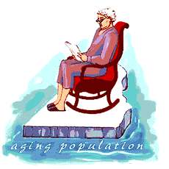


Psycho-Social Theories of Aging
Continuity Theory
Activity Theory
Disengagement Theory
Social exchange theory

Slide 54
The activity theory:
The activity theory, theory of ageing, normal theory of ageing, and lay theory of ageing, proposes that successful aging occurs when older adults stay active and maintain social interactions.
It takes the view that the ageing process is delayed and the quality of life is enhanced when old people remain socially active.
The theory was developed by Robert J. Havighurst in 1961.
The theory assumes that a positive relationship between activity and life satisfaction.
Notes:
Implicit: implied, understood

Slide 55
The activity theory occurs when individuals engage in a full day of activities and maintain a level of productivity to age successfully.
The activity theory basically says: the more you do, the better you will age.
It makes a certain kind of sense, too. People who remain active and engaged tend to be happier, healthier, and more in touch with what is going on around them.

Slide 56
Continuity Theory:
The continuity theory of normal aging states that older adults will usually maintain the same activities, behaviors, personality traits and relationships as they did in their earlier years of life.
According to this theory, older adults try to maintain this continuity of lifestyle by adapting strategies that are connected to their past experiences.
The continuity theory states that individuals who age successfully continue habits, preferences, lifestyle, and relationships through midlife and later.

Slide 57
People who are doing well in midlife, who are happy, healthy, and should carry over the habits and ideals that made them that way.
the continuity theory fails to consider people who have unhealthy habits, preferences, and the like in their middle age.
These people are aging poorly in their midlife and will continue to deteriorate in older age with their poor lifestyle.

Slide 58
Disengagement theory
The disengagement theory of aging states that "aging is an inevitable, mutual withdrawal or disengagement, resulting in decreased interaction between the aging person and others in the social system he belongs to".
The theory claims that it is natural and acceptable for older adults to withdraw from society.
The theory was formulated by Cumming and Henry in 1961 in the book Growing Old, and it was the first theory of aging that social scientists developed.
Thus, this theory has historical significance in gerontology.

Slide 59
Social exchange theory:
Social interaction between individuals and groups continues as long as everyone profits from the interaction.

Slide 60
Developmental theory
Erik Erikson’s Eight Stages of Life; Stages throughout the life course.
This theory states that each stage of life has a psychosocial crisis that must be accomplished and lays the foundation for the next stage.
The senior’s behavior and feelings depend on how he/she has mastered earlier developmental crisis.
“Unsuccessful resolution of the last crisis may result in a sense of despair in which individuals view life as a series of misfortunes, disappointments, and failures”.

Slide 61
Erikson explains that the late adulthood is marked by a crisis between ego integrity and despair as older adults are looking back over their lives, evaluating it and coming to terms with it.
They develop integrity if they successfully resolve the crisis and experience a sense of satisfaction and accomplishment in their life. They will accept death with a sense of integrity, “as the healthy child will not fear life, the healthy adult will not fear death”.

Slide 62
At the same time, if they do not resolve the crisis successfully, they consider their achievements as a failure or unproductive, they will become dissatisfied with life and develop despair, leading to sadness, hopelessness depression or dependent. They are likely to feel that life is short and they can not accept that death is part of normal life cycle.

Slide 63
Thank you

